Slide 1
Week 14 Random Forest
2026.05.28

Slide 2




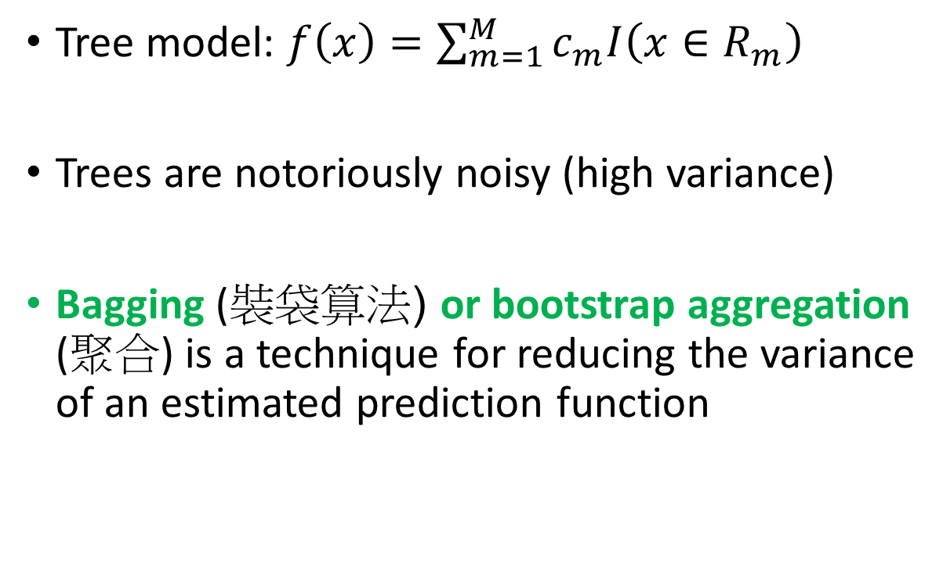






Random Forest
Tree model: $f\left(x\right)=\sum_{m=1}^{M}{c_{m}I\left(x∈R_{m}\right)}$
Trees are notoriously noisy (high variance)
Bagging (裝袋算法) or bootstrap aggregation (聚合) is a technique for reducing the variance of an estimated prediction function
$$c_{3}$$
$$c_{4}$$
$$c_{5}$$
$$R_{3}$$
$$R_{4}$$
$$R_{5}$$
$$c_{1}$$
$$c_{2}$$
$$R_{1}$$
$$R_{2}$$

Slide 3
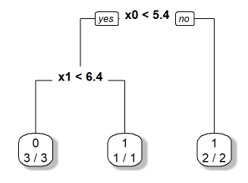
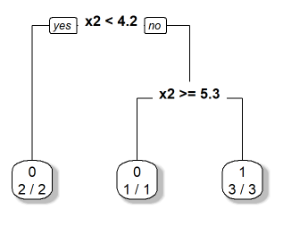
The tree models are sensitive to the training data set.
id | x0 | x1 | x2 | x3 | x4 | y
1 | 4.3 | 4.9 | 4.1 | 4.7 | 5.5 | 0
2 | 3.9 | 6.1 | 5.9 | 5.5 | 5.9 | 0
3 | 2.7 | 4.8 | 4.1 | 5 | 5.6 | 0
4 | 6.6 | 4.4 | 4.5 | 3.9 | 5.9 | 1
5 | 6.5 | 2.9 | 4.7 | 4.6 | 6.1 | 1
6 | 2.7 | 6.7 | 4.2 | 5.3 | 4.8 | 1
id | x0.2 | x1.2 | x2 | x3 | x4 | y
1 | 4.3 | 4.9 | 4.1 | 4.7 | 5.5 | 0
2 | 6.5 | 4.1 | 5.9 | 5.5 | 5.9 | 0
3 | 2.7 | 4.8 | 4.1 | 5 | 5.6 | 0
4 | 6.6 | 4.4 | 4.5 | 3.9 | 5.9 | 1
5 | 6.5 | 2.9 | 4.7 | 4.6 | 6.1 | 1
6 | 2.7 | 6.7 | 4.2 | 5.3 | 4.8 | 1
https://www.youtube.com/watch?v=v6VJ2RO66Ag

Slide 4
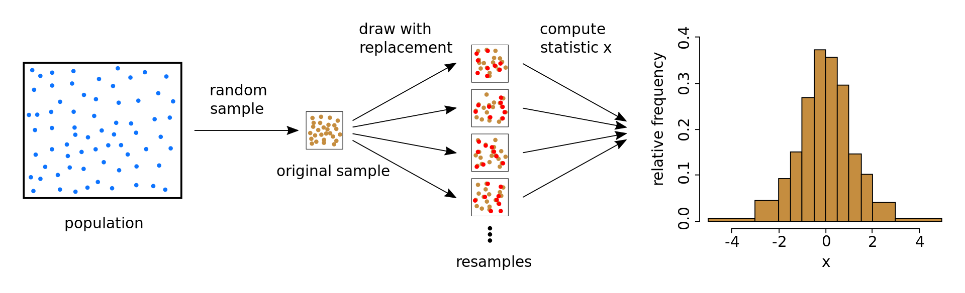
Bagging, bootstrap
Bagging: uses the bootstrap to improve the estimate or a prediction.
Bootstrap (拔靴法): a resampling technique used to estimate statistics on a population by sampling a dataset with replacement
https://upload.wikimedia.org/wikipedia/commons/thumb/4/4a/Illustration_bootstrap.svg/1920px-Illustration_bootstrap.svg.png

Slide 5
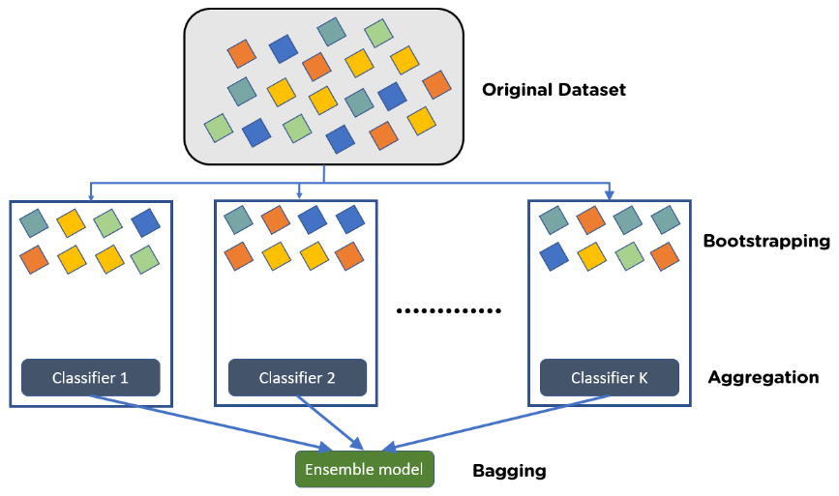
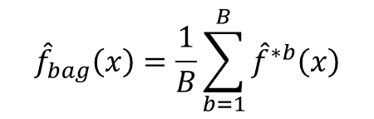



Bagging: The essential idea(基本想法) in bagging is to average many noisy but approximately unbiased models, and hence reduce the variance.
$${\hat{f}}^{∗1}\left(x\right)$$
$${\hat{f}}^{∗2}\left(x\right)$$
$${\hat{f}}^{∗B}\left(x\right)$$
$${\hat{f}}_{bag}\left(x\right)=\frac{1}{B}\sum_{b=1}^{B}{{\hat{f}}^{∗b}\left(x\right)}$$
https://www.simplilearn.com/ice9/free_resources_article_thumb/Bagging.PNG

Slide 6

Bagging: trees are ideal candidates for bagging, since they can capture complex interaction structures in the data, and if grown sufficiently deep, have relatively low bias.
https://www.simplilearn.com/ice9/free_resources_article_thumb/Bagging.PNG

Slide 7
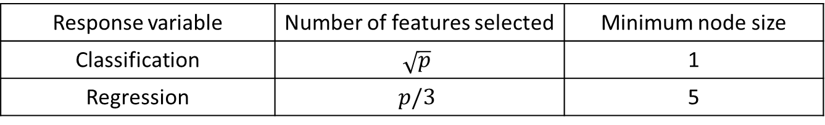
Random Forest
Why is it called random?
Bootstrapping: not using the same data for every tree, less sensitive to the original training data
Random feature selection: reduce the correlation between the trees (if use every feature then most of your trees will have the same decision nodes and will act very similarly. That will increase the variance.
Recommendations:
B=? (How many trees)
Response variable | Number of features selected | Minimum node size
Classification | $$\sqrt{p}$$ | 1
Regression | $$p/3$$ | 5

Slide 8
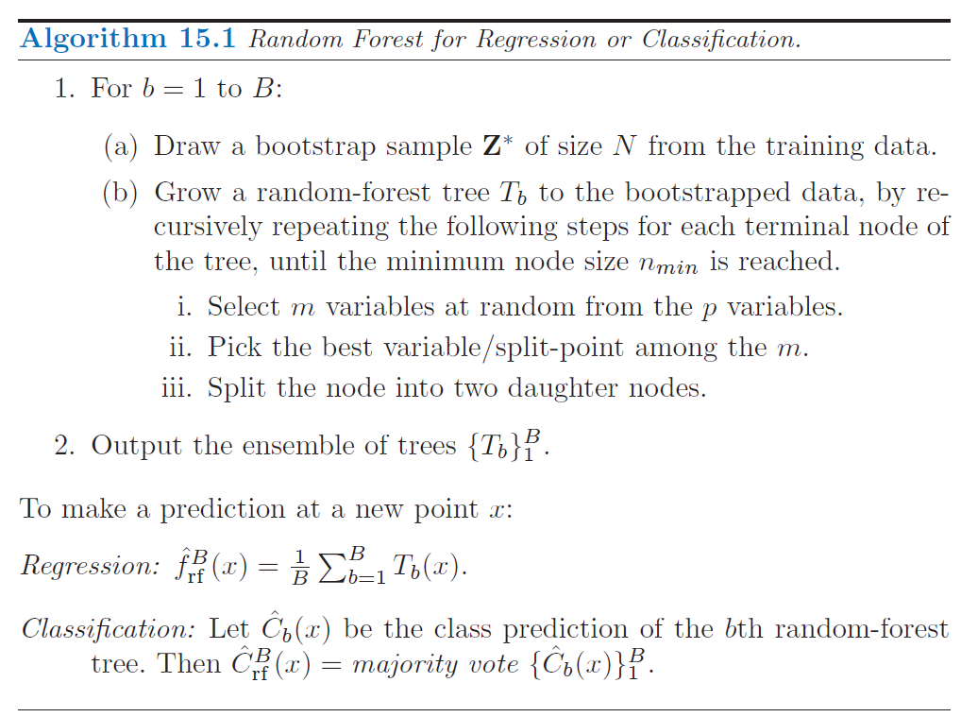
Random Forest

Slide 9
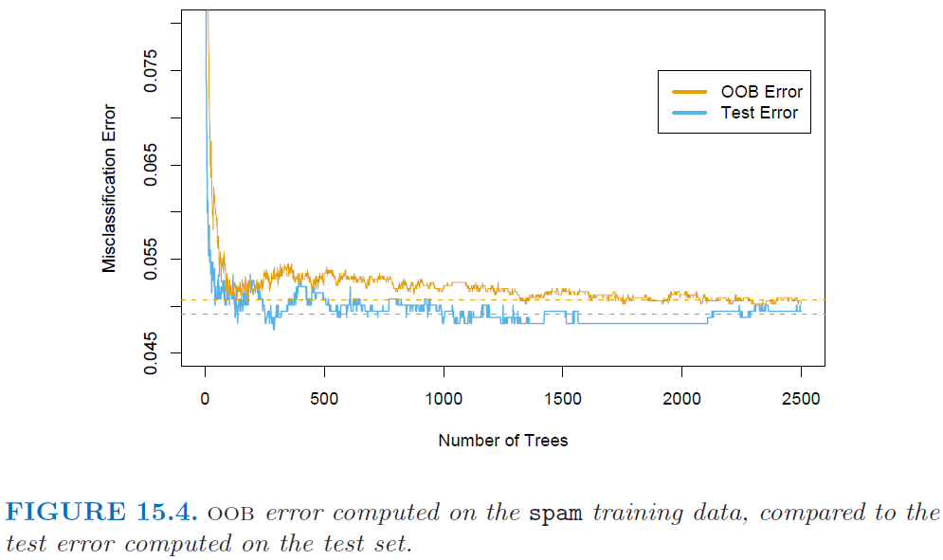

Random Forest: B=?
Out-of-bag (OOB) sample: For each observation $z_{i}=\left(x_{i},y_{i}\right)$, construct its random forest predictor by averaging only those trees corresponding to bootstrap samples in which $z_{i}$ did not appear.
The error rate stabilize at about 200 trees. 200 trees would be sufficient. (B=200)

Slide 10
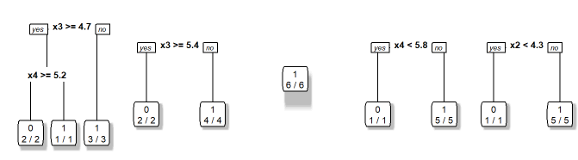





5 Bootstrap samples
Training data set
id | x0 | x1 | x2 | x3 | x4 | y
1 | 4.3 | 4.9 | 4.1 | 4.7 | 5.5 | 0
2 | 3.9 | 6.1 | 5.9 | 5.5 | 5.9 | 0
3 | 2.7 | 4.8 | 4.1 | 5 | 5.6 | 0
4 | 6.6 | 4.4 | 4.5 | 3.9 | 5.9 | 1
5 | 6.5 | 2.9 | 4.7 | 4.6 | 6.1 | 1
6 | 2.7 | 6.7 | 4.2 | 5.3 | 4.8 | 1
id
4
2
6
5
4
1
id
5
6
4
2
6
2
id
6
6
4
6
6
6
id
4
4
5
4
3
4
id
4
4
5
4
3
4
Random feature selection
$$x_{3},x_{4}$$
$$x_{3},x_{2}$$
$$x_{2},x_{0}$$
$$x_{3},x_{4}$$
$$x_{1},x_{2}$$
https://www.youtube.com/watch?v=v6VJ2RO66Ag

Slide 11
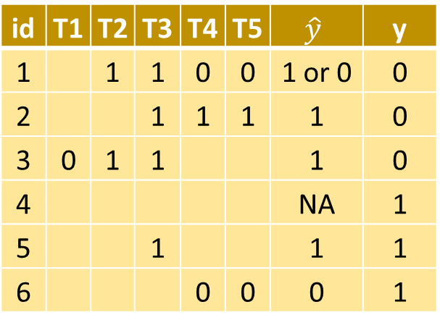
Training data set
id | x0 | x1 | x2 | x3 | x4 | y
1 | 4.3 | 4.9 | 4.1 | 4.7 | 5.5 | 0
2 | 3.9 | 6.1 | 5.9 | 5.5 | 5.9 | 0
3 | 2.7 | 4.8 | 4.1 | 5 | 5.6 | 0
4 | 6.6 | 4.4 | 4.5 | 3.9 | 5.9 | 1
5 | 6.5 | 2.9 | 4.7 | 4.6 | 6.1 | 1
6 | 2.7 | 6.7 | 4.2 | 5.3 | 4.8 | 1
id
4
2
6
5
4
1
id
5
6
4
2
6
2
id
6
6
4
6
6
6
id
4
4
5
4
3
4
id
4
4
5
4
3
4
$$x_{3},x_{4}$$
$$x_{3},x_{2}$$
$$x_{2},x_{0}$$
$$x_{3},x_{4}$$
$$x_{1},x_{2}$$
OOB sample
3
1,3
1,2,3,5
1,2,6
1,2,6
id | T1 | T2 | T3 | T4 | T5 | $$\hat{y}$$ | y
1 |  | 1 | 1 | 0 | 0 | 1 or 0 | 0
2 |  |  | 1 | 1 | 1 | 1 | 0
3 | 0 | 1 | 1 |  |  | 1 | 0
4 |  |  |  |  |  | NA | 1
5 |  |  | 1 |  |  | 1 | 1
6 |  |  |  | 0 | 0 | 0 | 1
Misclassification rate = 3.5/5

Slide 12
Training data set
id | x0 | x1 | x2 | x3 | x4 | y
1 | 4.3 | 4.9 | 4.1 | 4.7 | 5.5 | 0
2 | 3.9 | 6.1 | 5.9 | 5.5 | 5.9 | 0
3 | 2.7 | 4.8 | 4.1 | 5 | 5.6 | 0
4 | 6.6 | 4.4 | 4.5 | 3.9 | 5.9 | 1
5 | 6.5 | 2.9 | 4.7 | 4.6 | 6.1 | 1
6 | 2.7 | 6.7 | 4.2 | 5.3 | 4.8 | 1
id
4
2
6
5
4
1
id
5
6
4
2
6
2
id
6
6
4
6
6
6
id
4
4
5
4
3
4
id
4
4
5
4
3
4
$$x_{3},x_{4}$$
$$x_{3},x_{2}$$
$$x_{2},x_{0}$$
$$x_{3},x_{4}$$
$$x_{1},x_{2}$$
New sample: Make Prediction!
x0 | x1 | x2 | x3 | x4
2.8 | 6.2 | 4.4 | 5.3 | 5.5
0:2 trees
1:3 trees
=> Predict: y=1
https://www.youtube.com/watch?v=v6VJ2RO66Ag

Slide 13
Reference:
The Elements of Statistical Learning, 2nd, Hastie & Tibshirani & Friedman
https://rpubs.com/allan811118/R_programming_08
https://www.youtube.com/watch?v=v6VJ2RO66Ag
https://rpubs.com/lhchien/1091295

